Slide 1
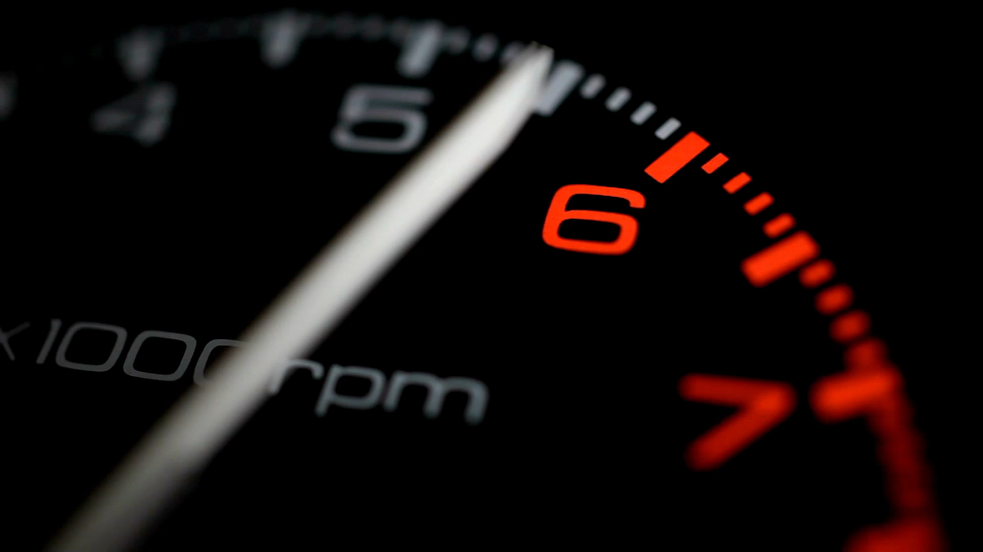
Vintage Car Mileage Predictor
Using Machine Learning for Predicting Car Mileage
Presented by: Usman Javed Swati
Roll # : BAIB232004

Slide 2

Introduction
Overview
This project aims to develop a machine learning model to predict the mileage of vintage cars based on various features.
Objective
To provide accurate mileage predictions using different regression models.

Slide 3
Future Potential
Accurate Valuation: Better estimate the condition and value of vintage cars for buying, selling.
Scheduled Maintenance: Plan maintenance schedules more effectively.
Historical Data Analysis: Contribute to understanding trends and usage patterns of vintage cars.

Slide 4
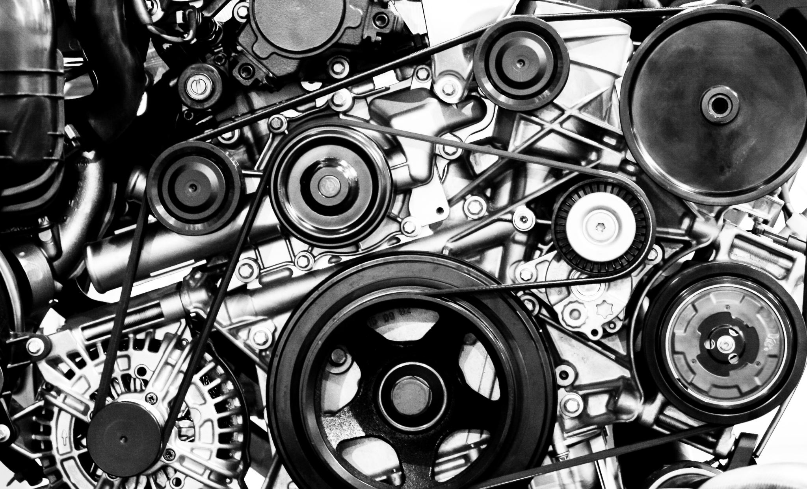
Dataset
Source
The dataset contains details of vintage cars, including features like cylinders, displacement, horsepower, weight, acceleration, year, origin, and name.
Features
mpg (Y)
cylinders (X)
displacement (X)
horsepower
weight (X)
acceleration
year
origin
name

Slide 5
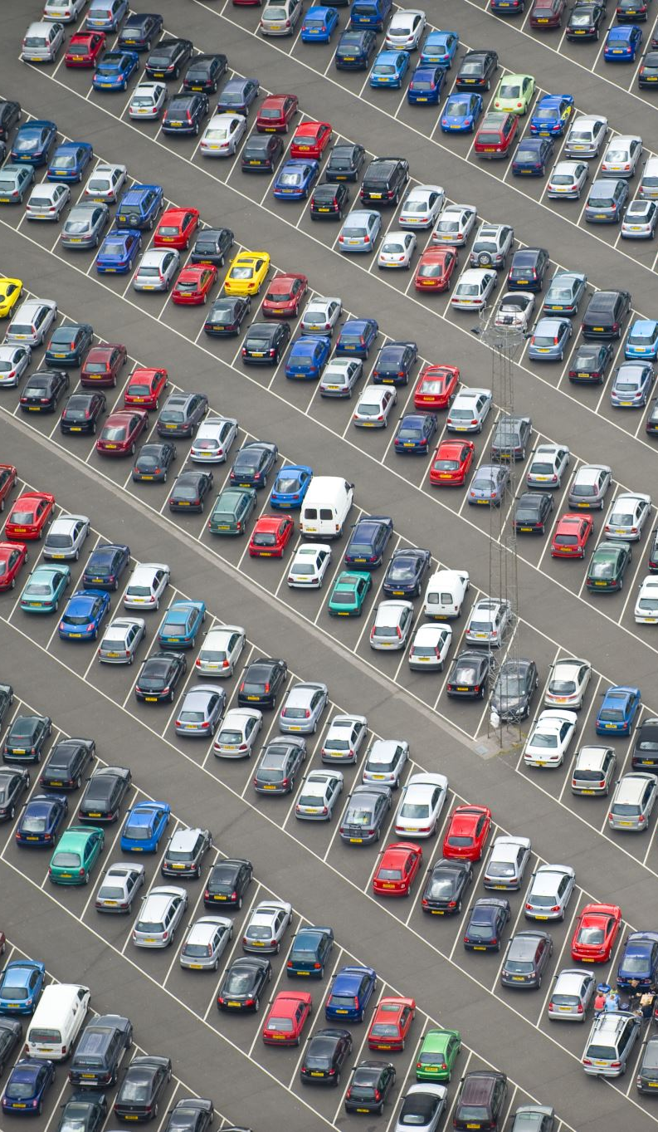
Data Exploration and Cleaning
Exploration
Initial data exploration provided insights into the distribution and relationships of various features.
Cleaning Steps
Handling missing values
Removing outliers

Slide 6
Model Selection Cars
List of Models
Linear Regression
Ridge Regression
Lasso Regression
ElasticNet Regression
Decision Tree
Random Forest
Gradient Boosting
AdaBoost
XGBoost
SVM
K-Nearest Neighbors
Neural Network (MLP)
Evaluation Metrics
Mean Absolute Error (MAE)
Mean Squared Error (MSE)
Root Mean Square Error (RMSE)
R-squared (R²)
Cross-Validation
Used cross-validation to assess model performance and avoid overfitting.

Slide 7
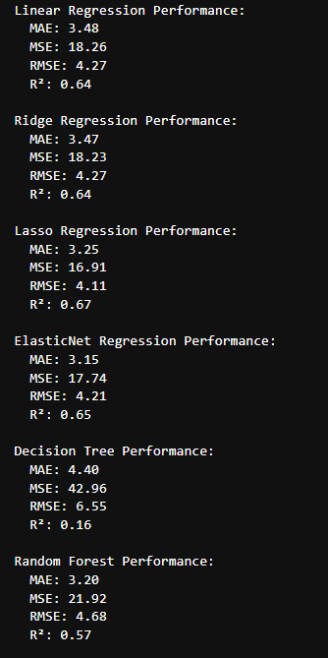
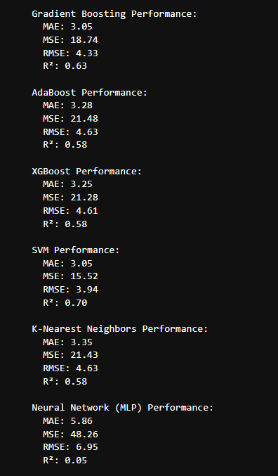
Model Selection
Since SVM has the highest score, we will choose SVM as our model

Slide 8
Function Explanation - predict_mileage
Purpose
The `predict_mileage` function estimates the mileage of a vintage car given its displacement, weight, and number of cylinders.
Parameters
`displacement`: Engine displacement of the car.
`weight`: Weight of the car.
`cylinders`: Number of cylinders in the car's engine.
`model`: The trained machine learning model used for prediction.
`scaler`: The scaler used for feature scaling.
Steps
Create DataFrame
An input DataFrame is created with the provided displacement, weight, and cylinders.
Scale Features
The input data is scaled using the provided scaler to match the model's training data scale.
Predict Mileage
The model predicts the mileage in miles per gallon (MPG) based on the scaled input data.
Convert to km/L
The predicted mileage is converted from miles per gallon (MPG) to kilometers per liter (km/L) using the conversion factor (1 MPG ≈ 0.425144 km/L).
Return Values
The function returns the predicted mileage in both MPG and km/L.

Slide 9
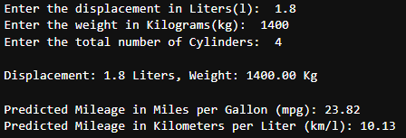
Results
Model Performance
Presented the performance metrics for each model.
Best Model
Identified the best-performing model based on the evaluation metrics.

Slide 10
Thank You !

